Slide 1
Posterior abdominal wall Skeleton & vessels of Paw
By: m. g. hamaad

Slide 2
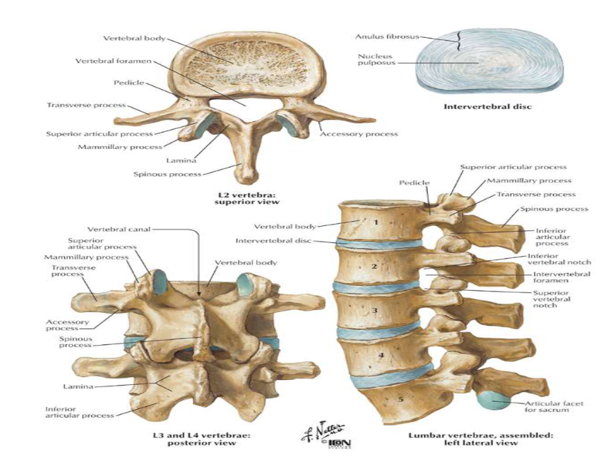
Lumbar vertebrae
General features:
There are 5 L V.
Lumbar vertebrae have massive body.
Vertebral foramen is triangular.
Spine is quadrangular.
Superior articular facet is concave. Inferior articular facet is convex.
Posterior- inferior part of root of transverse process has a rough elevation called accessory process.

Slide 3
Lumbar vertebrae
classification:
Total number of lumbar vertebrae : 5 vertebrae.
Typical: first to fourth.
Atypical : fifth.

Slide 4
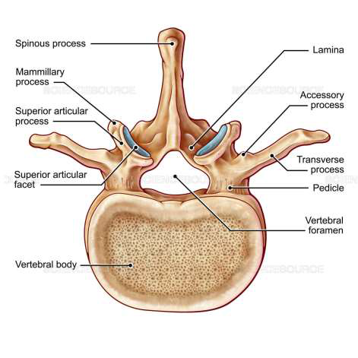
Typical Lumbar vertebrae
has:
Body.
Vertebral foramen.
Vertebral {neural} arch:
Pedicles.
Laminae.
Transverse processes.
Articular processes.
Spinous process.

Slide 5
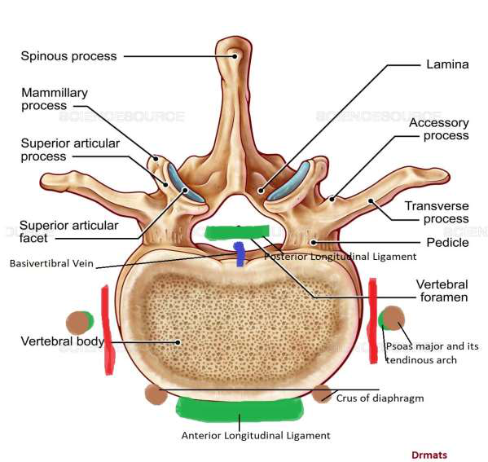
body
Large.
Has:
Anterior surface: provides attachment for:
Anterior longitudinal ligament.
Crura of diaphragm.
Lateral surfaces: provides attachment for:
Psoas major and its tendinous arch.
Posterior surface: provides attachment for:
Posterior longitudinal ligament.

Slide 6
Vertebral arch
pedicles:
Short & strong.
It has:
Superior vertebral notch: on its upper border.
Inferior vertebral notch: on inferior border, deeper more than superior one.
The notches of all pedicles together form intervertebral foramina: for spinal nerves.

Slide 7
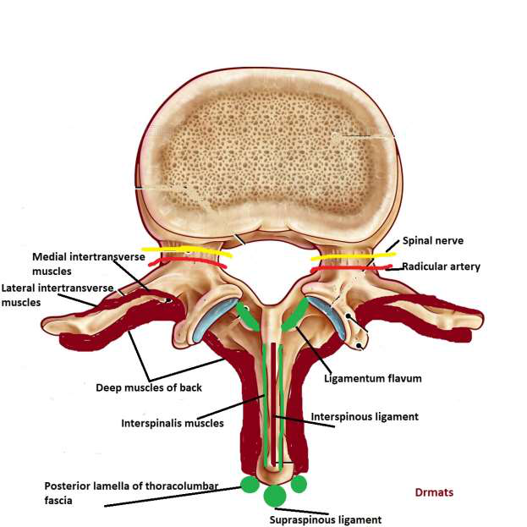
Vertebral arch
laminae:
Short and Thick.
Directed posterior- medially.
They provide attachment for:
Ligamentum flavum.
Deep muscles of back.

Slide 8
Vertebral arch
spine:
Quadrilateral.
Provides attachment for:
Supraspinatus ligament.
Thoracolumbar fascia.
Interspinous ligaments.
Interspinalis muscles.
Deep muscles of back.

Slide 9
Vertebral arch
Transverse Process (TP):
Tapering and Thin.
Homologous with ribs.
Provides attachment for:
Medial and lateral arcuate ligaments.
Iliolumbar ligament.
Thoracolumbar fascia.
Psoas major.
Quadratus lumborum.

Slide 10

Vertebral arch
Articular Process:
Has:
Superior articular facet: Concave, Medially.
Inferior articular facet: Convex, Laterally.
Posterior border of superior articular process contains: mamillary process.

Slide 11
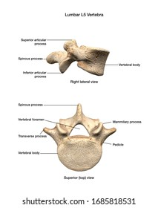
A typical vertebra: l5
Thick and short transverse process:
Connected to whole of pedicles and part of body.
The distance between inferior articular process is more than superior articular process.
The body is very much deeper anteriorly.

Slide 12
Vessels of paw

Slide 13
Vessels of paw
Vasculature of PAW includes:
Abdominal Aorta & its branches.
IVC & its tributaries.

Slide 14
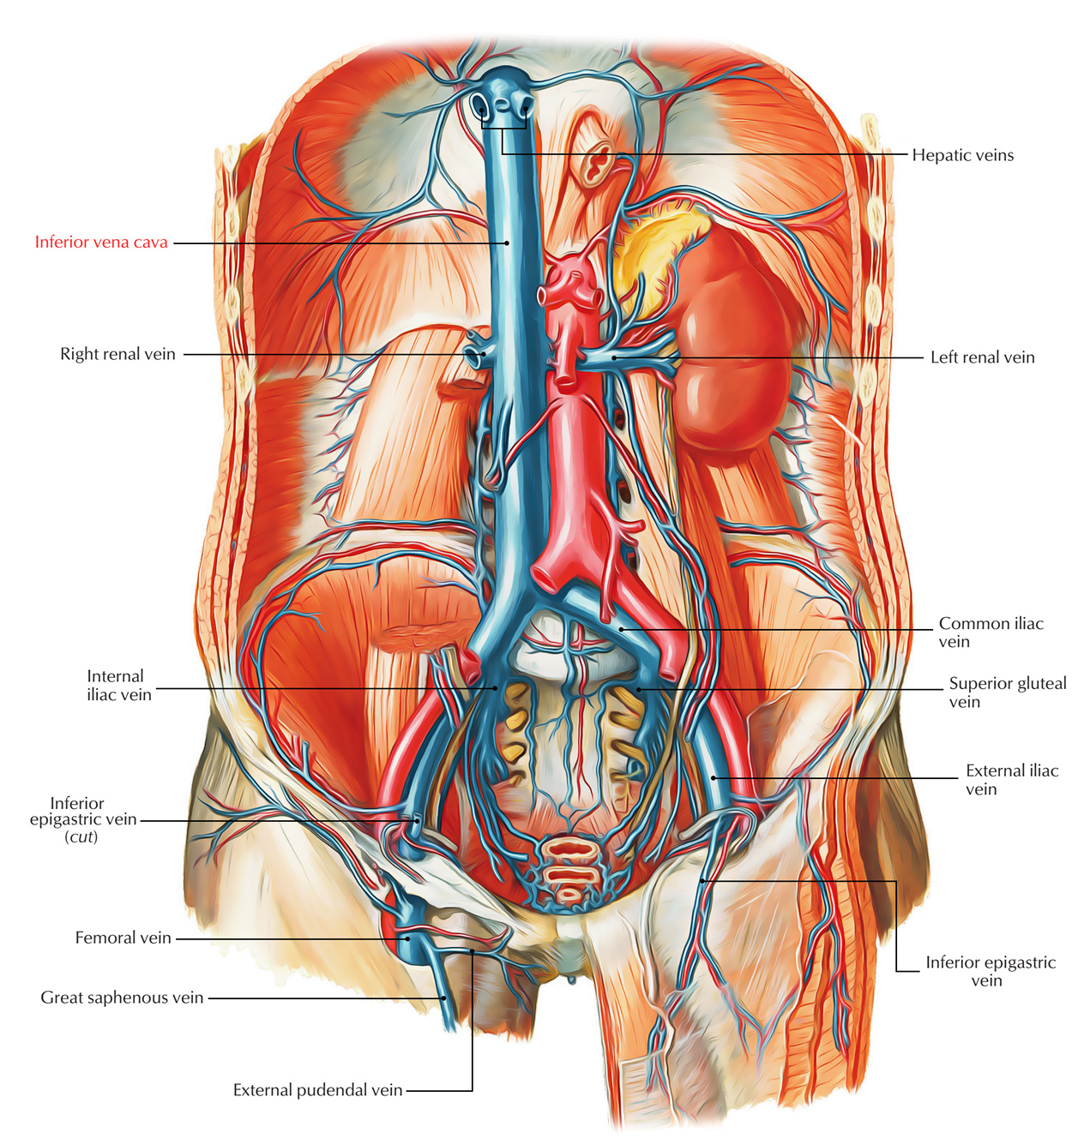
Abdominal aorta
Continuation of thoracic aorta.
Enters abdomen behind median arcuate line.
Infront of left side of T12 body.
Descends down to body of L4 {where it divides into the two common iliac arteries}.
It related to:
Splenic vein & pancreatic body: cross in front of it.
L. renal vein, uncinate process, 3rd part of duodenum.
IVC: on its right margin.

Slide 15
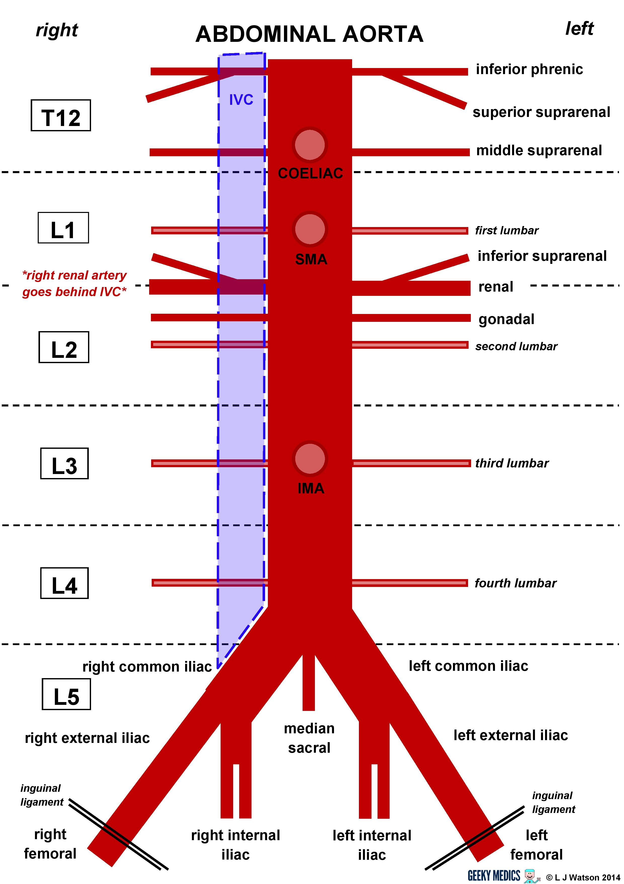
branches
Median sacral artery: from posterior surface of bifurcation area.
Single ventral branches:
Coeliac trunk {T12}.
Superior mesenteric A {L1}.
Inferior mesenteric A {L3}.
Lateral paired visceral branches:
Suprarenal As {T12, L1}.
Renal As {L1}.
Gonadal As {L2}.
Lateral paired AW branches:
Subcostal As {T12}.
Inferior phrenic As {T12}.
Lumbar As {L1- L4}.
Terminal branches:
R- L common iliac As {L4}.

Slide 16
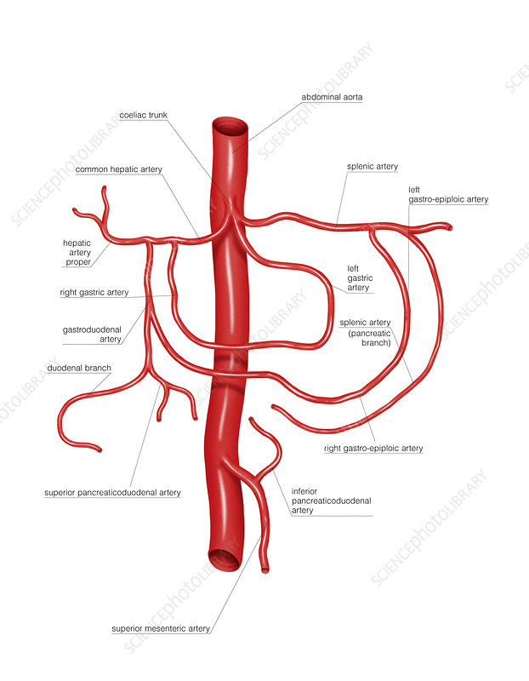
Coeliac trunk branches

Slide 17
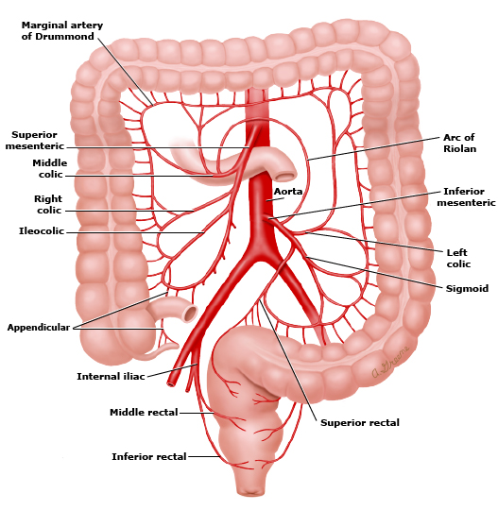
SM branches

Slide 18
IM branches

Slide 19
Inferior vena cava
It begins opposite L5 vertebra,
Formed by union of two common iliac veins behind the right common iliac artery.
It runs upwards on the right of the aorta.
It extends to the central tendon of the diaphragm.
It pierces diaphragm at level of T8.

Slide 20
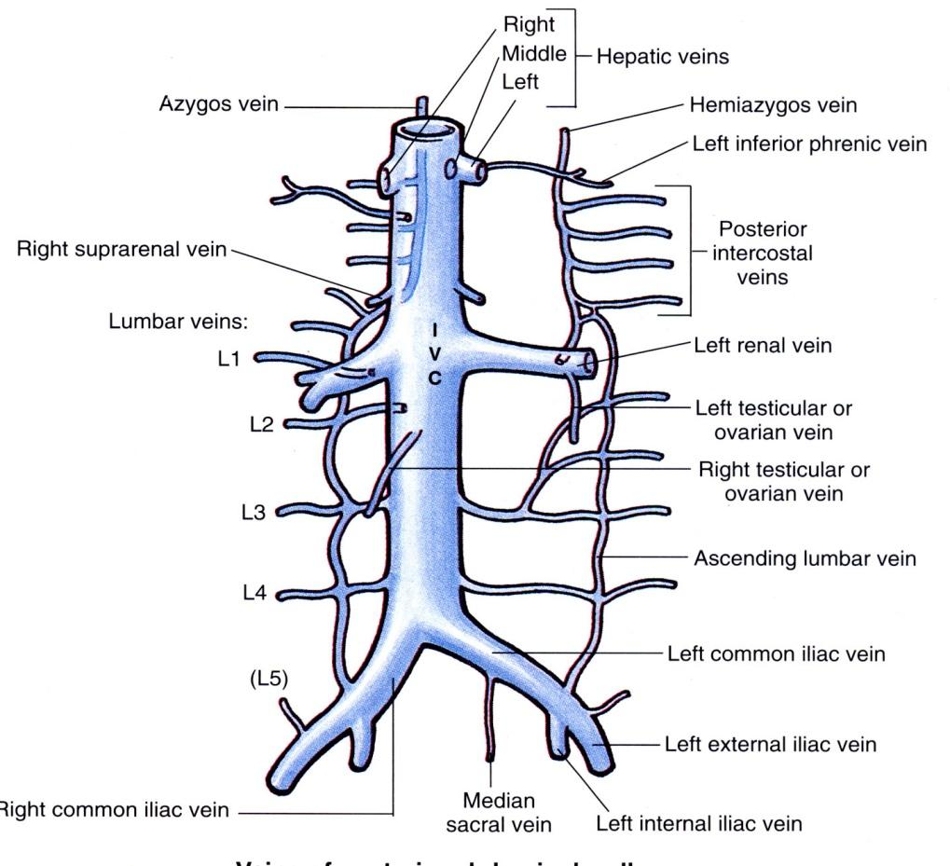
tributaries
Vena caval tributaries are not identical with the branches of the abdominal aorta.
There is no corresponding to the three ventral branches of aorta.
Tributaries include:
Hepatic veins.
Common iliac veins.
Lumbar veins.
R. gonadal vein (left one to left renal V).
R. suprarenal vein (left one to left renal V).
Inferior phrenic veins.

Slide 21
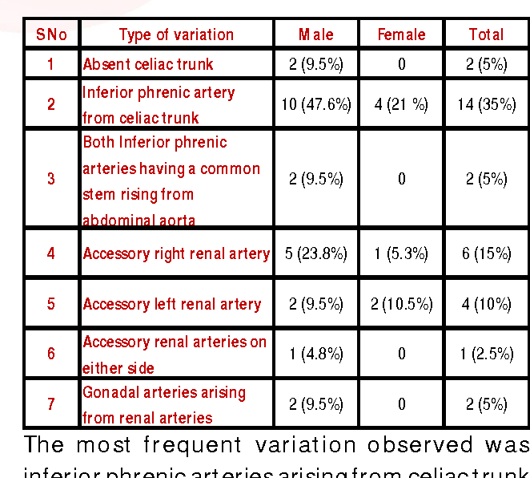
Variations in abdominal arteries

Slide 22
That is all

